Slide 1

Multimodal Banking (MDB) Attrition Project

Slide 2









Meet the Team
Kshitij Nitin Patil
Debbie Dai
Saravanan Hari Baskaran
Xinyan Li
Yuntong Ju
Mentored By
Tianyue Wang
Young Cheong

Slide 3

Executive Summary
Objective
Customer attrition remains a major financial risk; even small drops (78% in 2022 to 76% in 2023 (Patel, 2024)) in retention can cost hundreds of millions annually.
The purpose of the project is to build a multimodal churn-prediction framework using transactional, geolocation, and dialogue data.
Current State
Traditional single-modal and Survival models that rely on transaction data and account history are still popular ways
Temporal patterns and various interactions are neglected as they were treated as static observations over time
Data: Multimodal Banking Dataset (real data but hashed for some features), introduced in the paper Multimodal Banking Dataset: Understanding Client Needs through Event Sequences published by Sber AI Lab.
Target Definition: A customer is defined as churned when their activity drops below 20% below of their expected level.
Methodologies
LightGBM: baseline model as benchmark
TCN: sequential model, where each feature per customer treated as a sequence
Result: TCN outperforming the baseline and identifying likely churners and non-churners over 90% of the time.

Slide 4
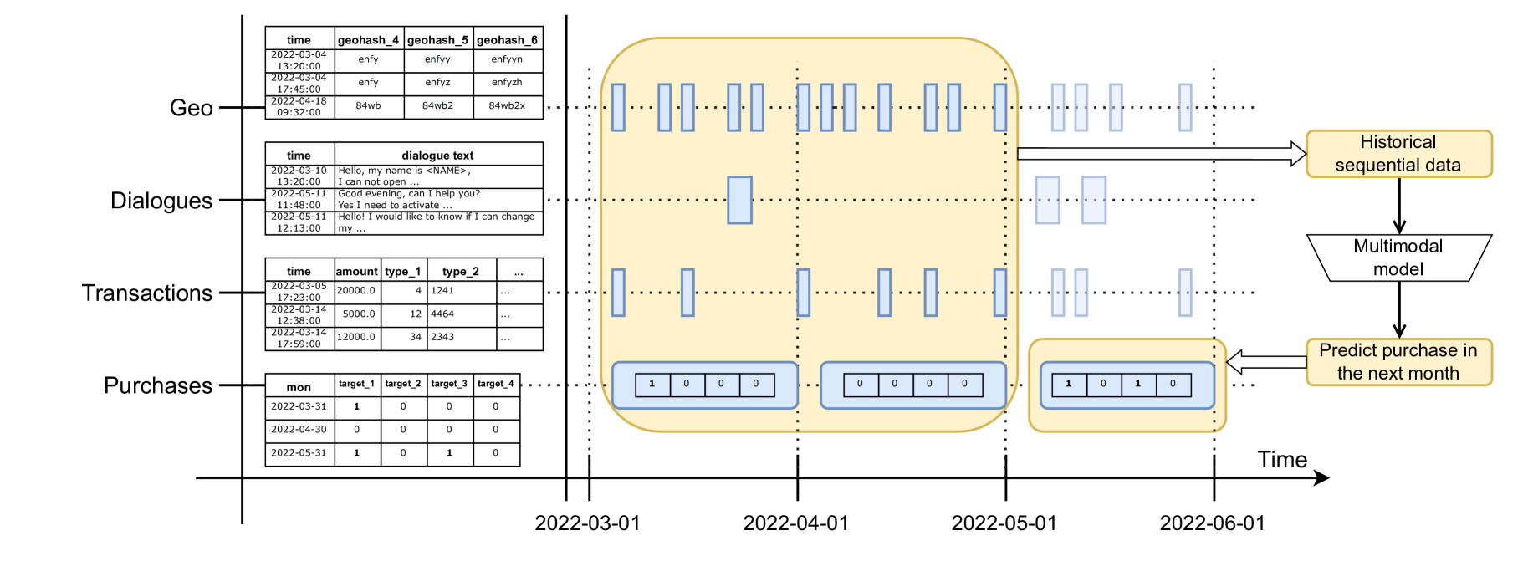
Data Description
Rather than using the entire MDB data, we applying the MDB mini version of this project
66.3M
217K
38.8M
After merging them all together by clients, the dataset is rich with 236K samples, with time length is from Apr - Oct 2022, and around 98 thousand of unique clients.

Slide 5
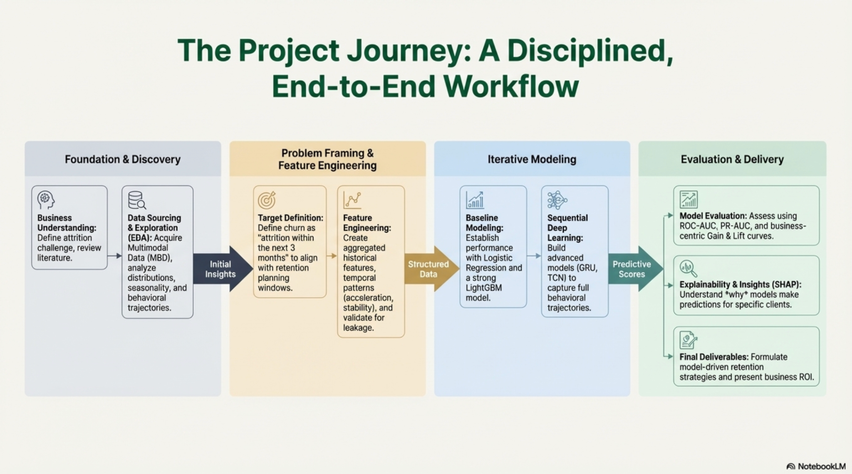


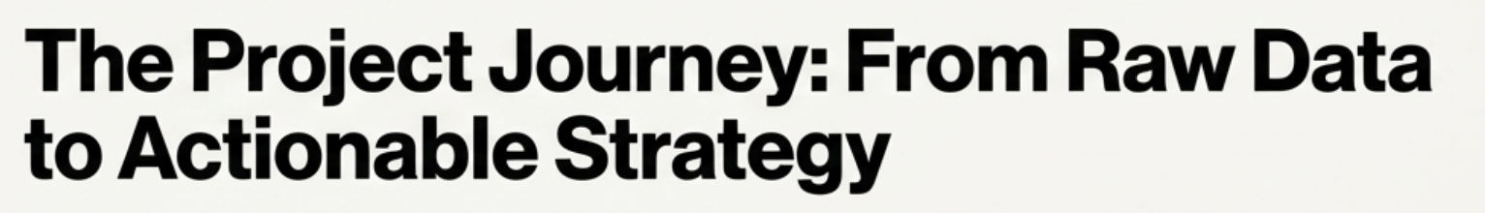
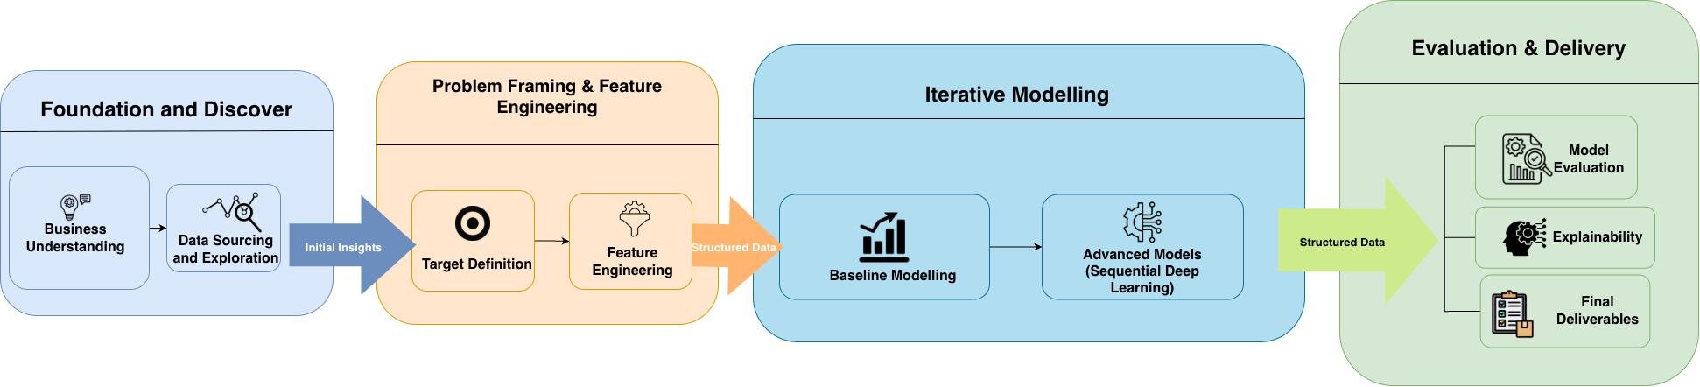

Slide 6


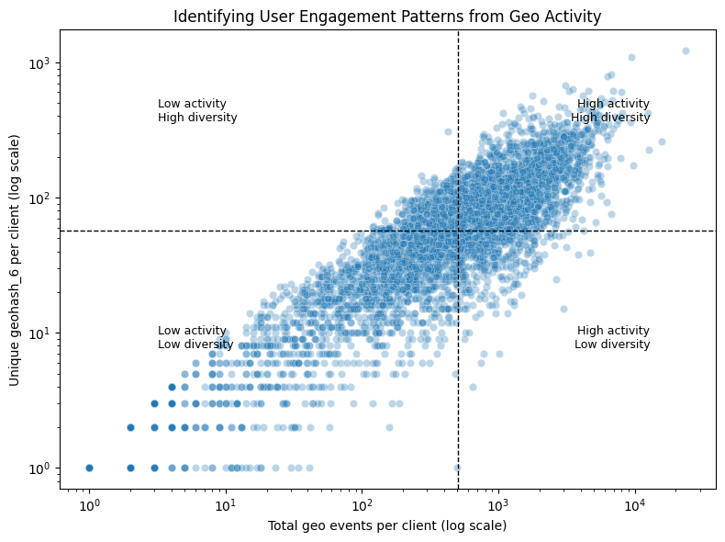
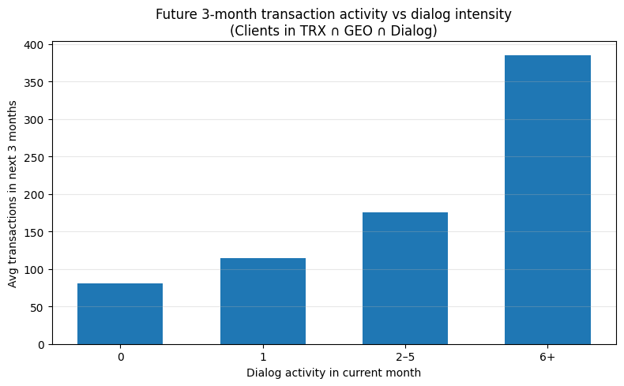
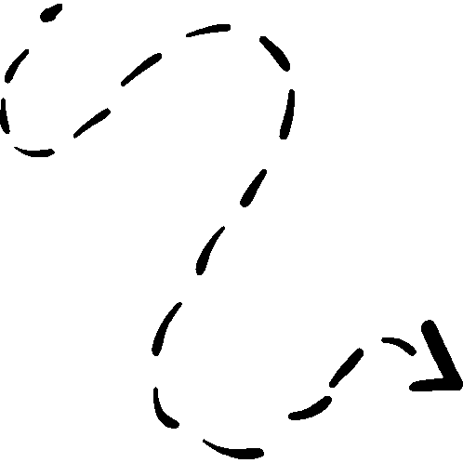
Behavioral Signals from Geo and Dialogue
Mobility patterns + Intent signals = clearer understanding of customer engagement
geo mobility + dialog behaviors =>
help reveal early signals of customer engagement or potential attrition

Slide 7

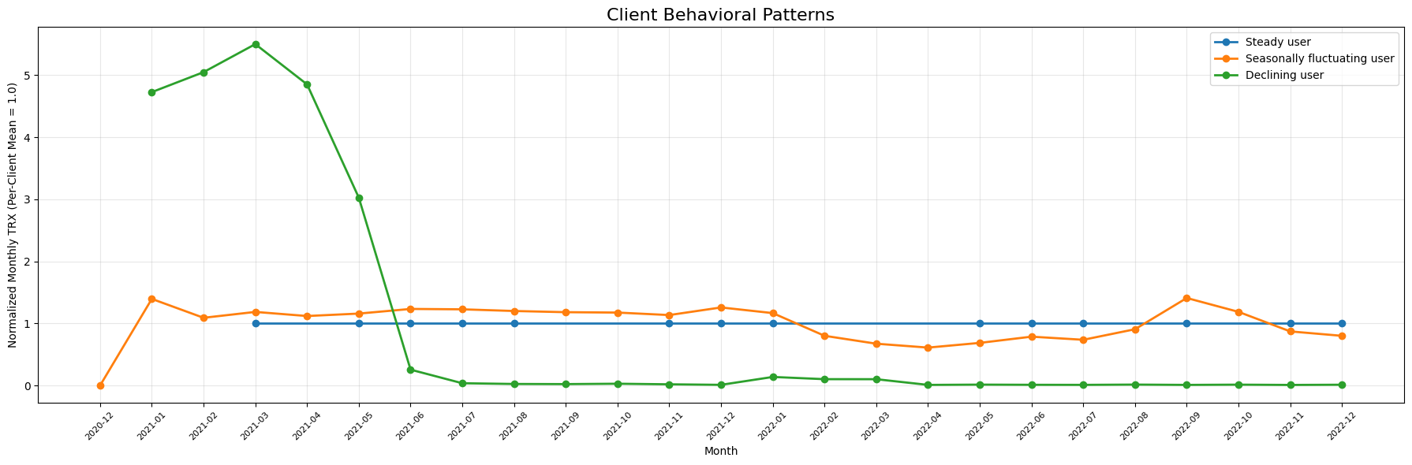
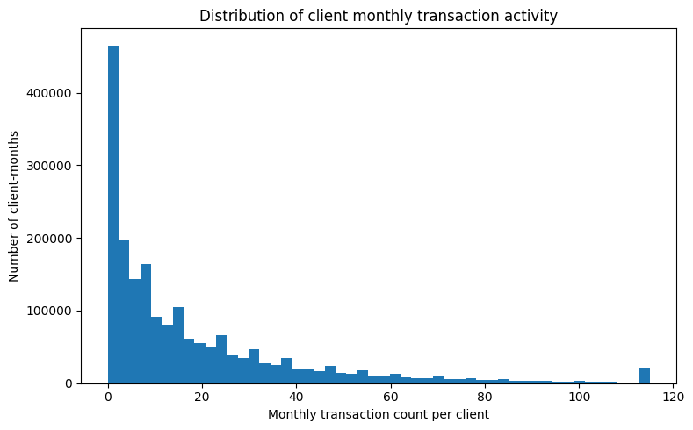
Uncovering Early Warning Signals of Customer Attrition
Transactional Fingerprints Reveal Three Key Client Archetypes
Distribution of client monthly transactions
Client activity is heavily skewed
-> Relative changes in behavior should be far more predictive of churn than absolute counts like the declining pattern users

Slide 8
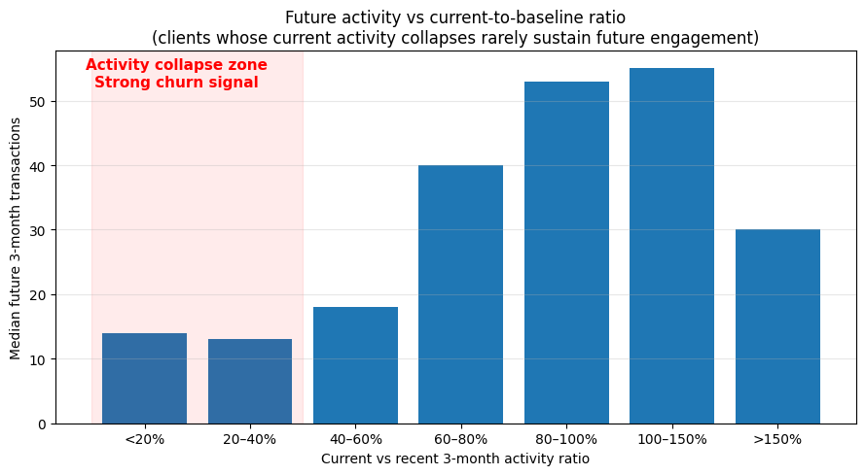

The anatomy of attrition: From a sudden drift to collapse
The Tipping point

Slide 9
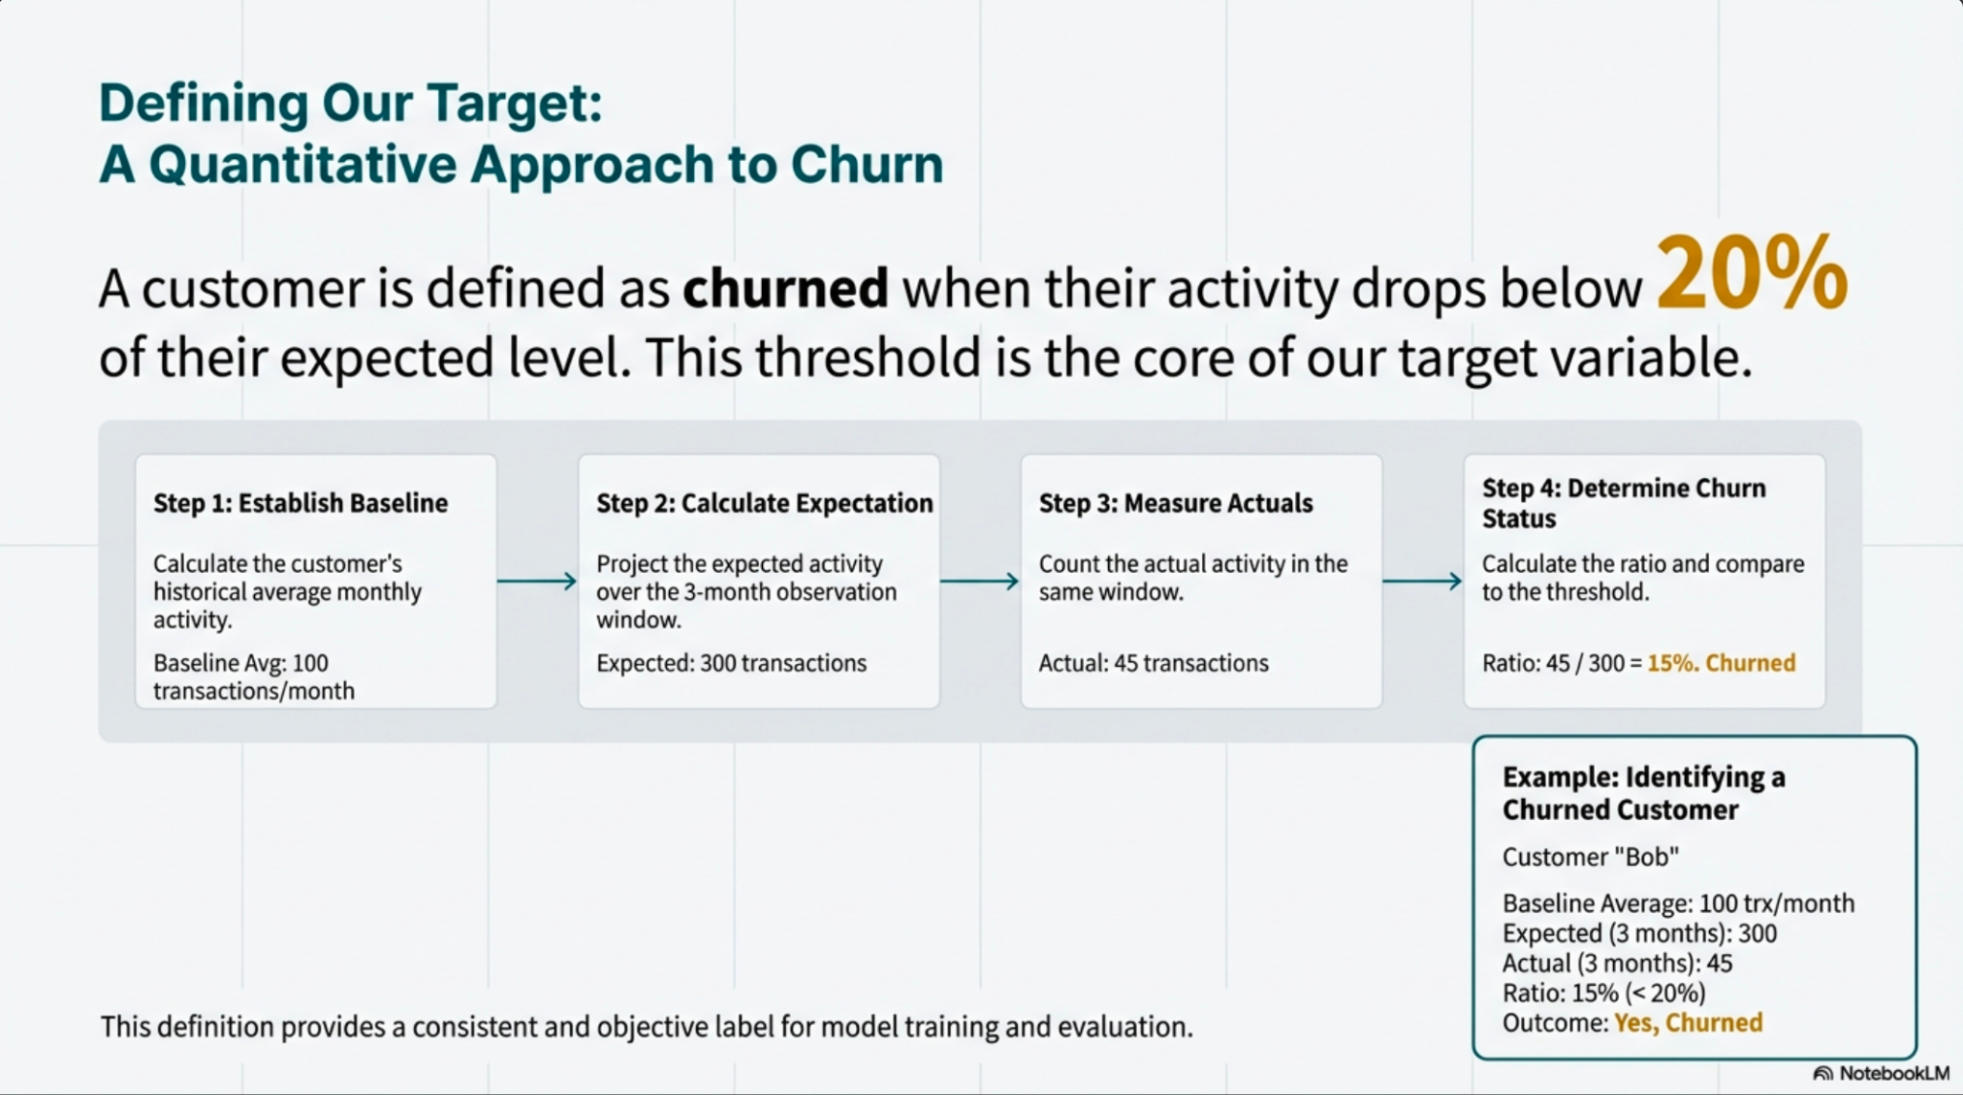
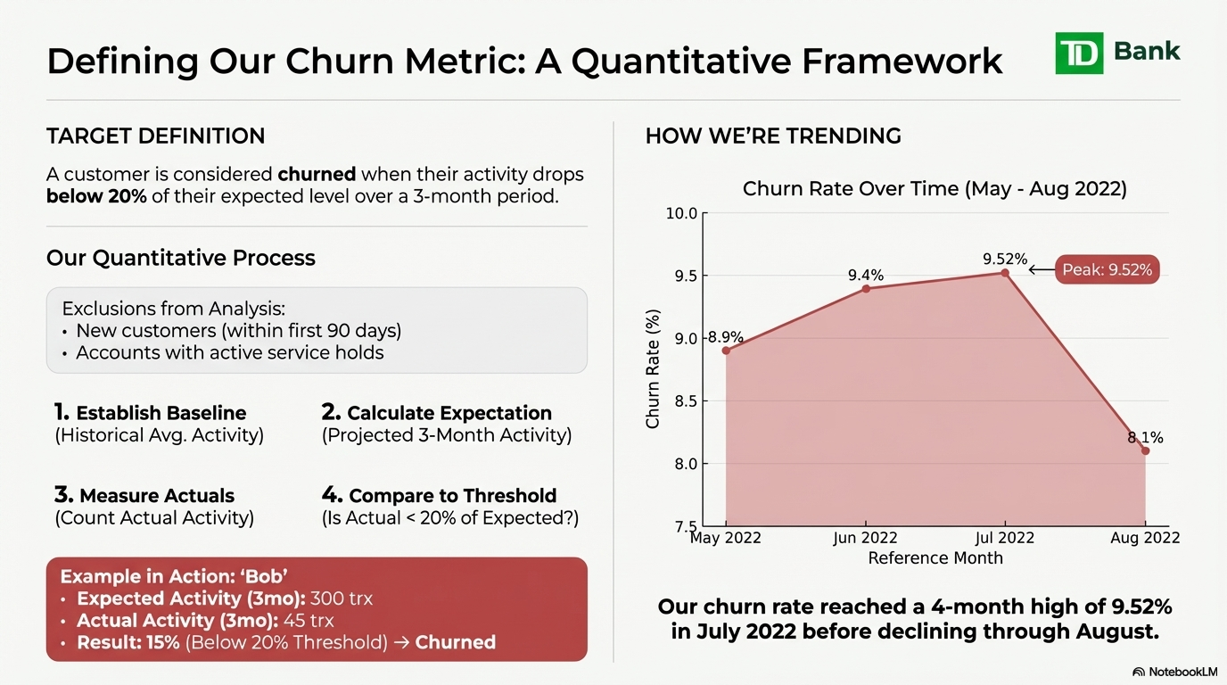
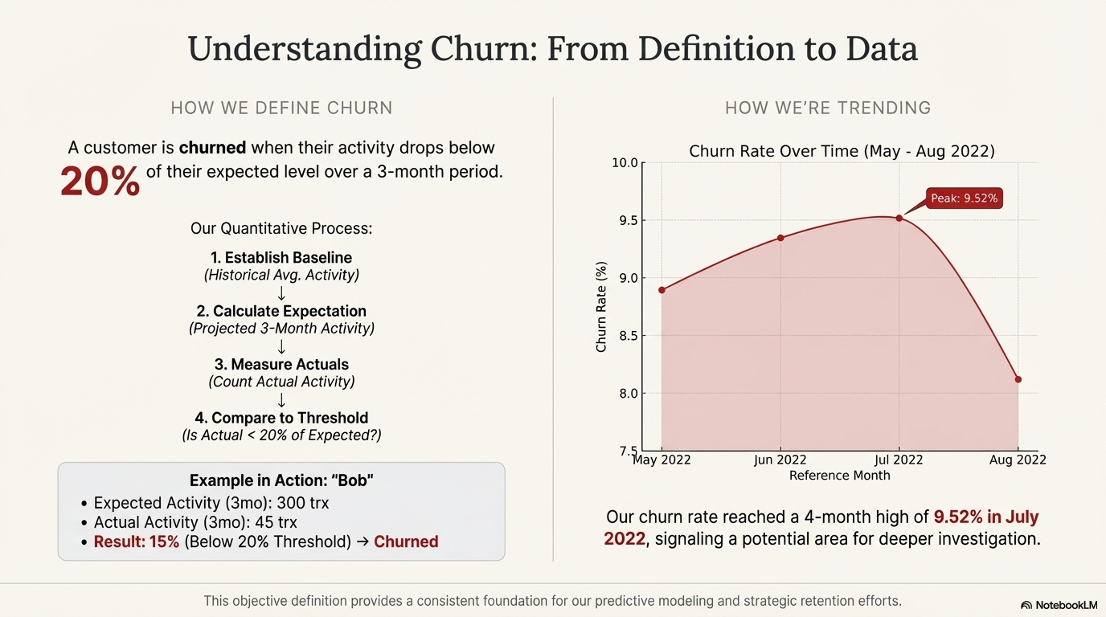
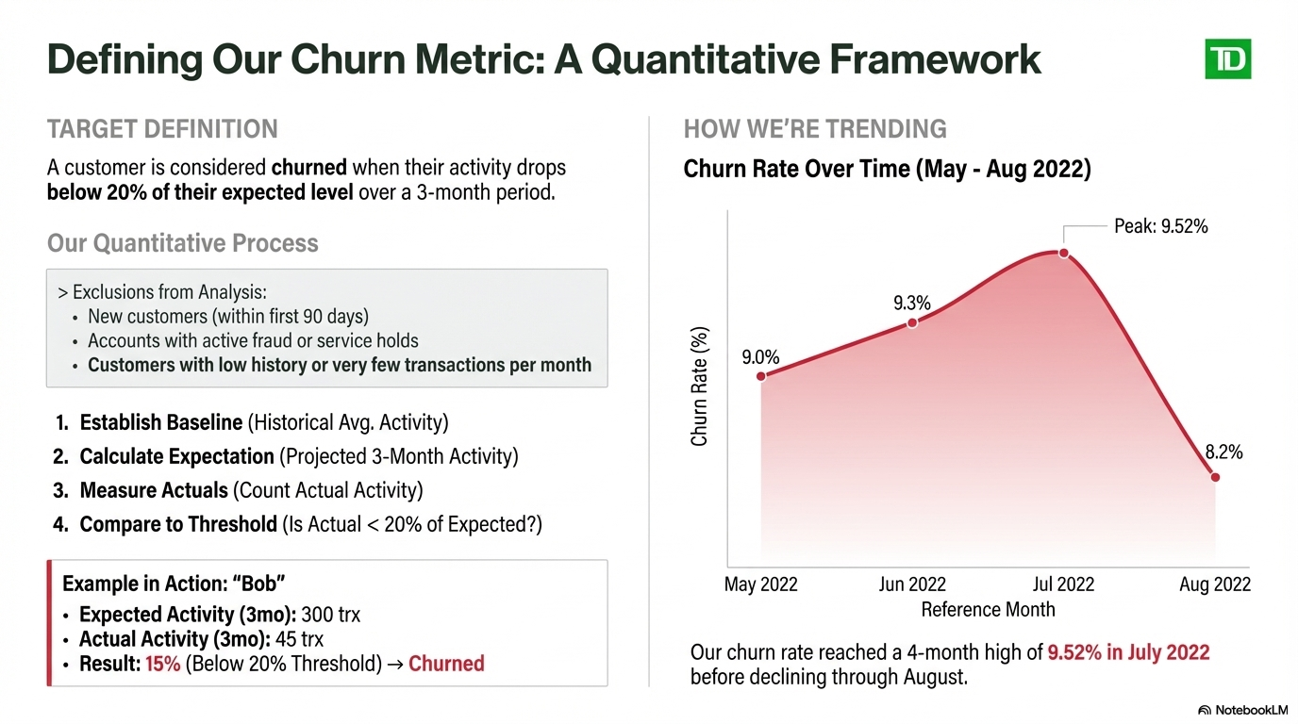
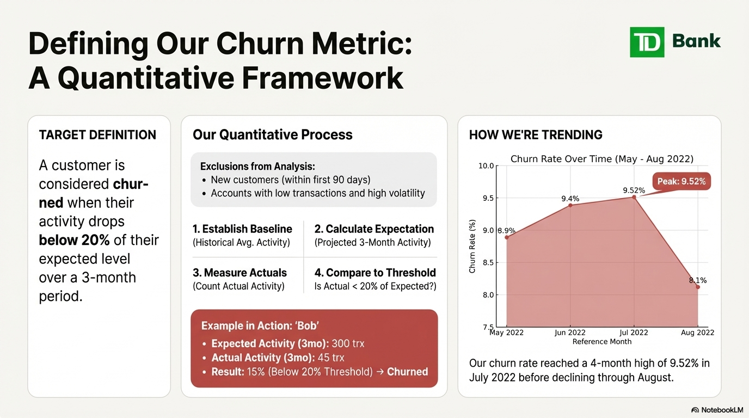
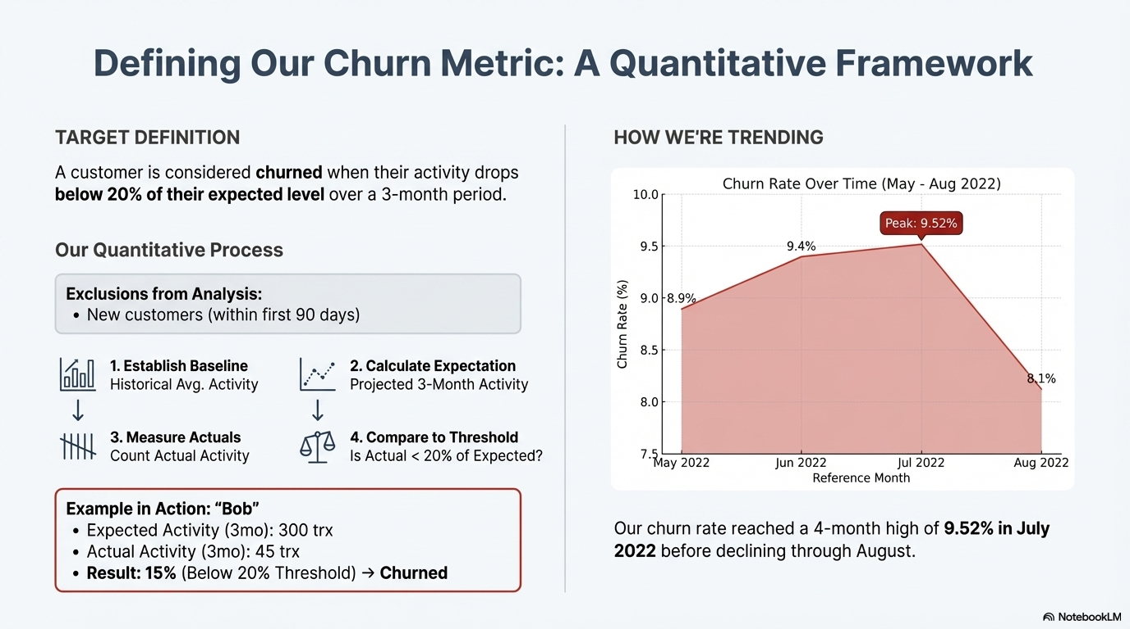
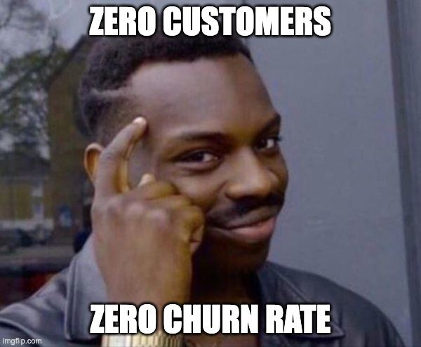


Churn Definition
Multimodal Banking Attrition Project

Slide 10
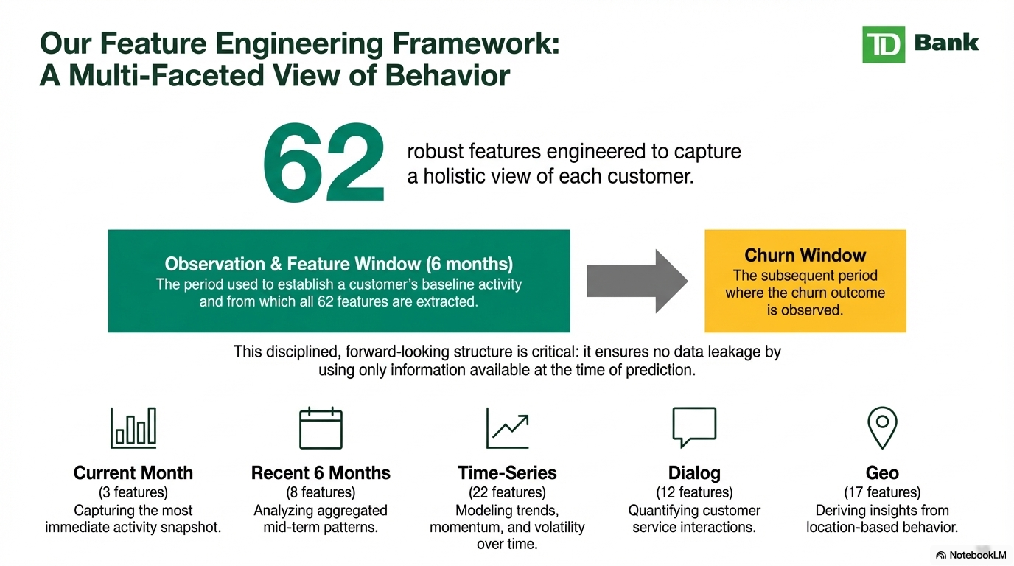








Current Months
Recent 3 Months
Time-Series
Dialog
Geo

Slide 11
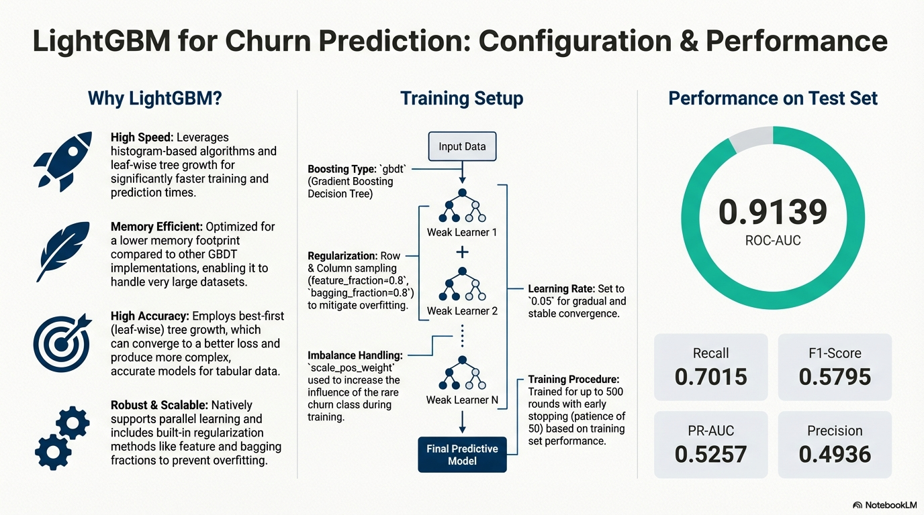
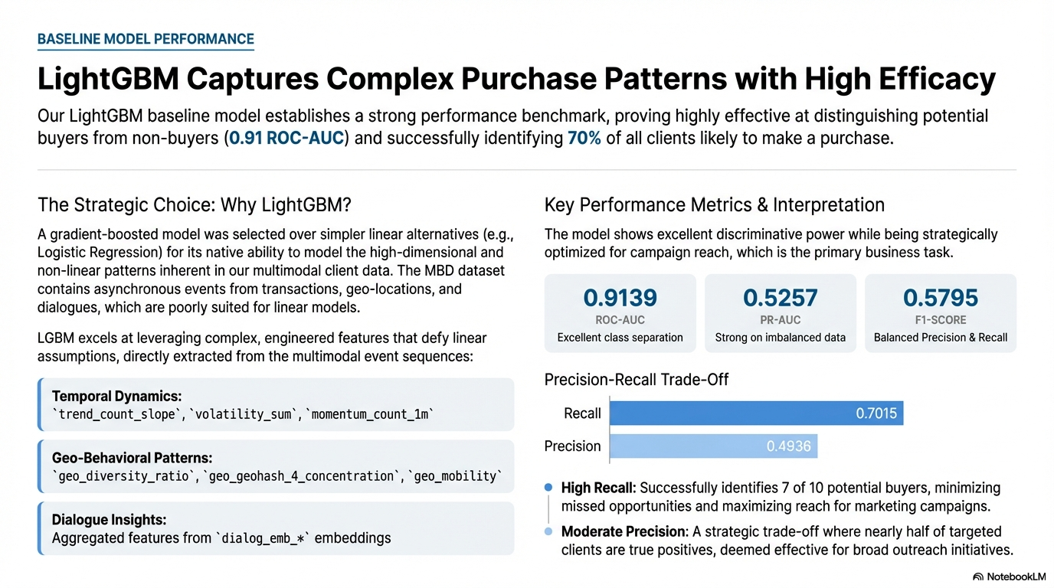
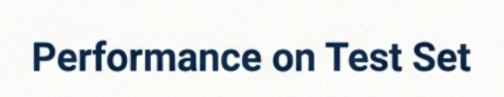

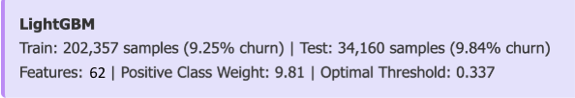
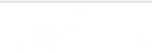
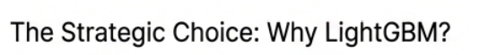

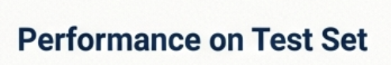
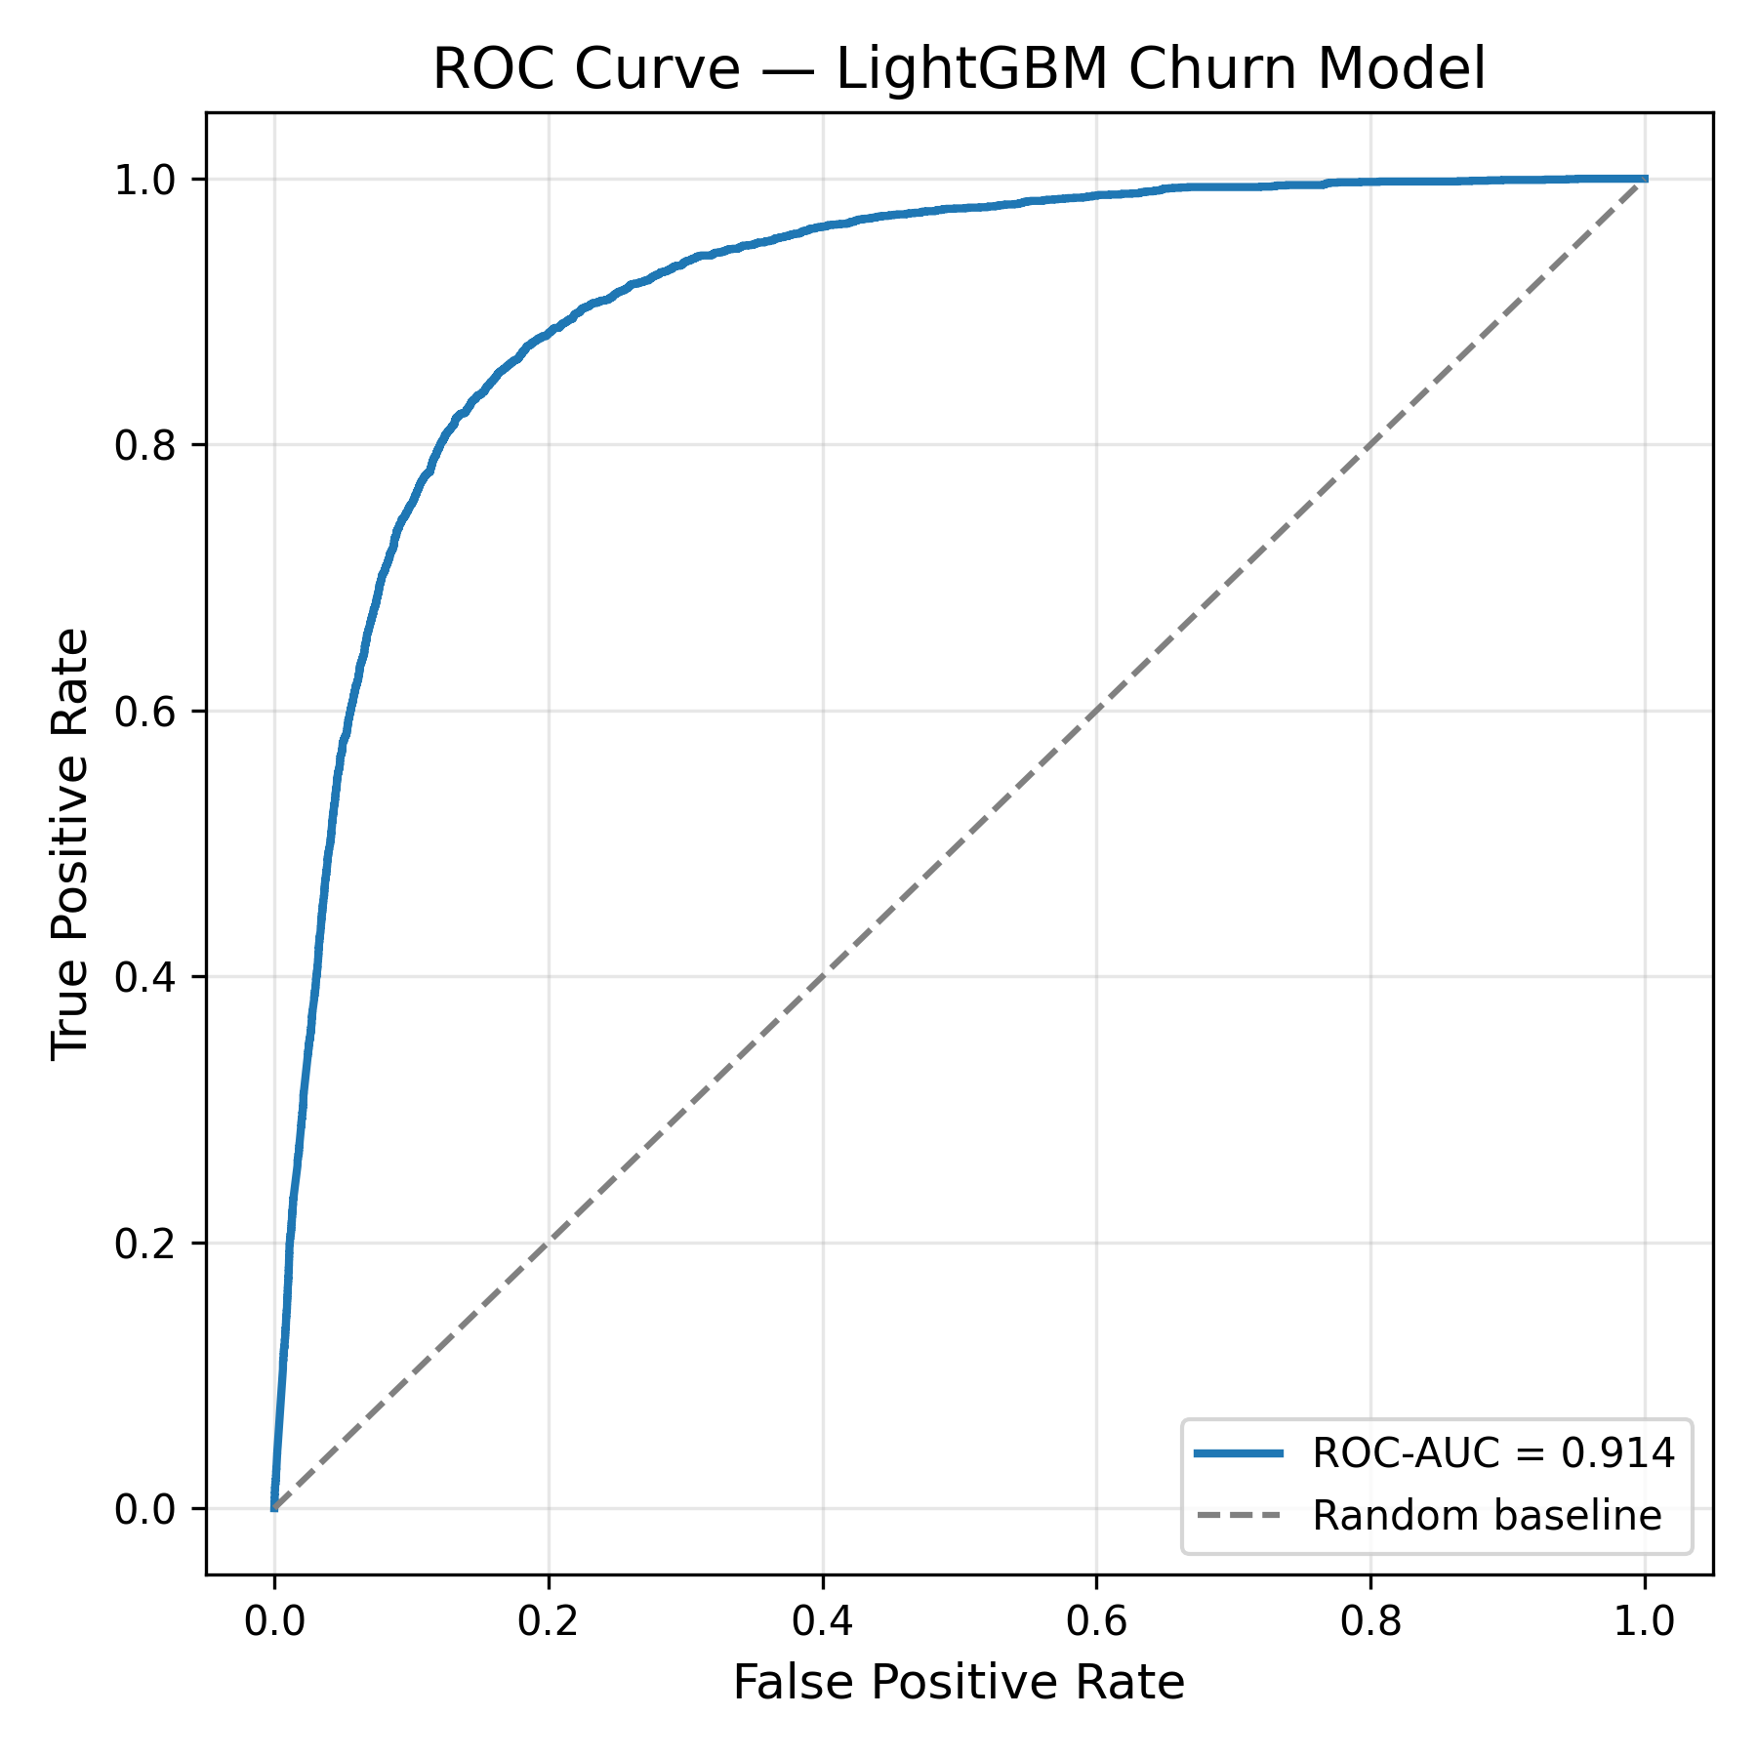
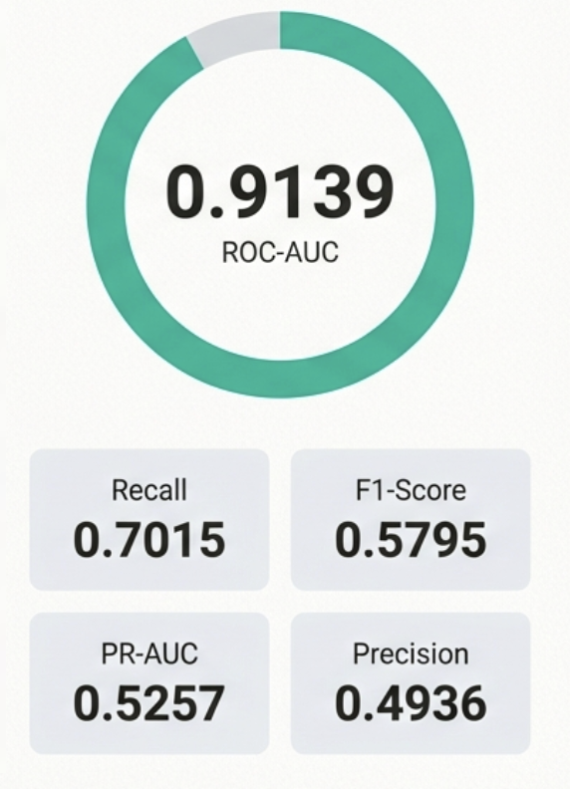

LightGBM Captures Complex Diverse Signals with High Efficacy
High performance with low latency
-> Suitable for large customer bases
Excels with imbalance targets (like churn)
-> our dataset contains 7% churn rate
Captures complex nonlinear interactions
-> e.g., drop in recency + decrease in activity + location shift
Great baseline and model-selection anchor
->gives feature importance signals that guide feature engineering

Slide 12


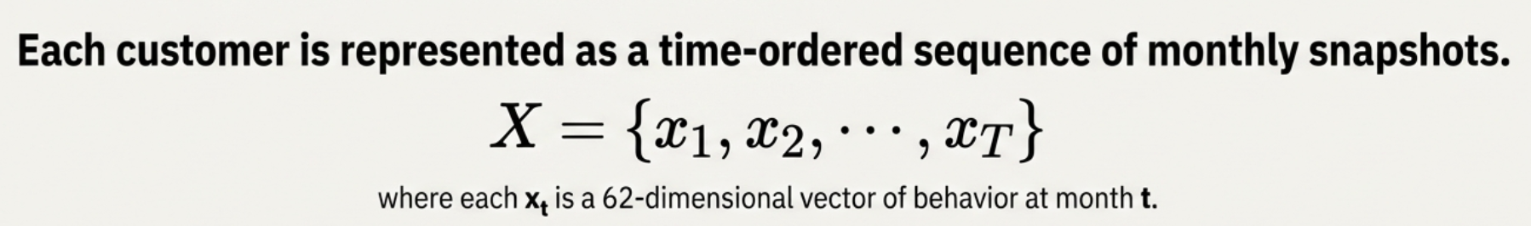

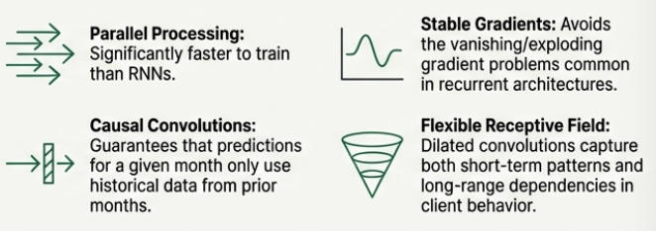






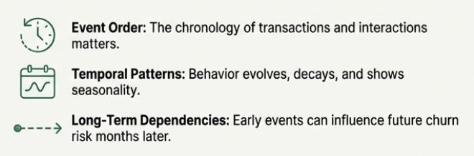
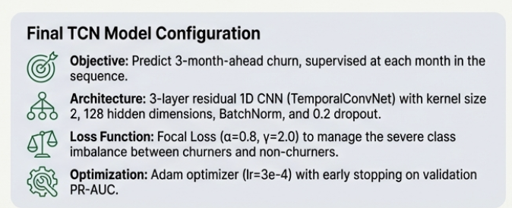
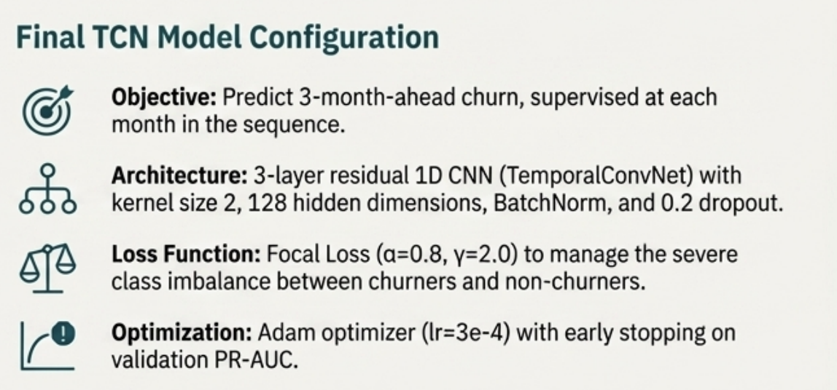
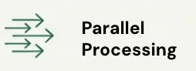
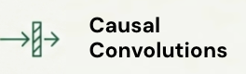
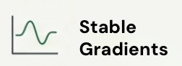
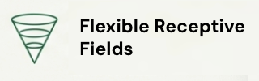
Beyond Static Features: Capturing Behavioral Dynamics with TCN
Why Sequential Model?
How customer behavior is represented?
Customer attrition is a process, not an event
Parallel Processing
Stable
Gradients
Monthly Aggregation Daily events (geo, dialogue, transactions) → 1 monthly feature vector (62 features) 1 timestep = 1 calendar month
Sequence Length Entire available behavioral history per client Prediction - most recent month T
Causal Convolutions
Flexible Receptive Fields
TCN Input Tensor: [N_clients, T_months, 62_features]
The Architecture: Why a Temporal Convolutional Network (TCN)?

Slide 13

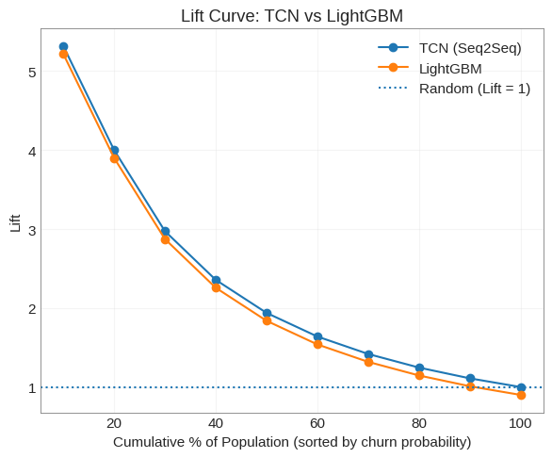
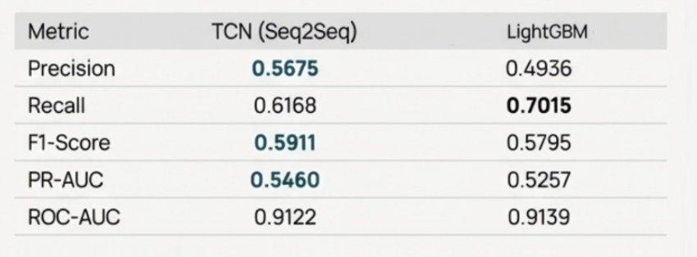
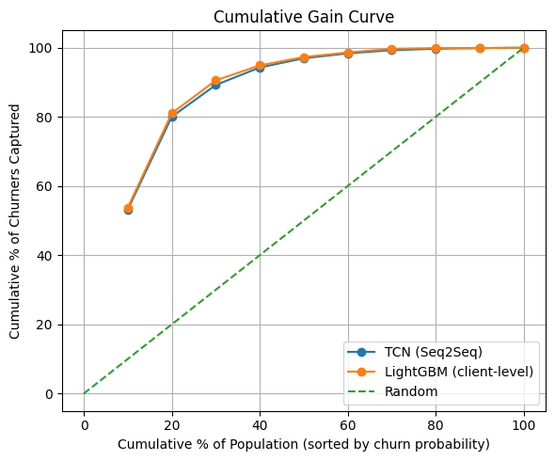
TCN Outperforms Tabular Baseline in Predictive Power and Business Impact
Model Performance Metrics
Cumulative Lift Curve
Targeting top 10% delivers ~5× lift vs random
Cumulative Gain Curve
Targeting top 20% identifies ~80% of churners
TCN marginally outperforms our baseline LightGBM

Slide 14

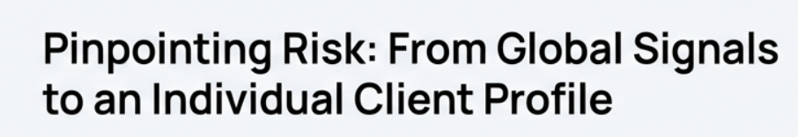
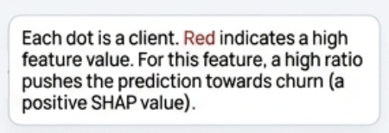
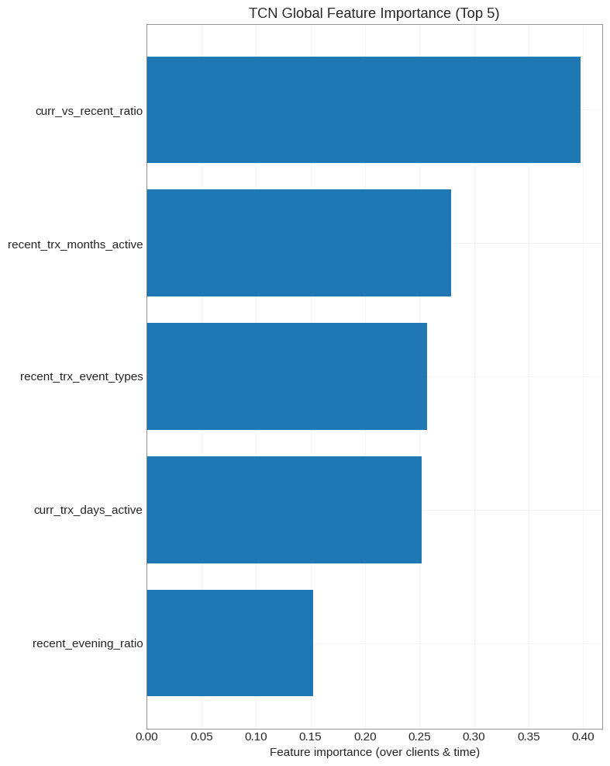
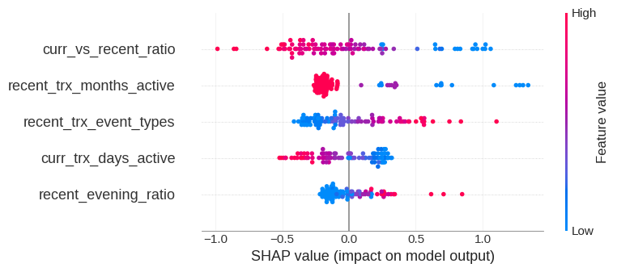
Top 5 Global Churn Signals (Client Level)
High-risk patterns visible across global and individual levels

Slide 15

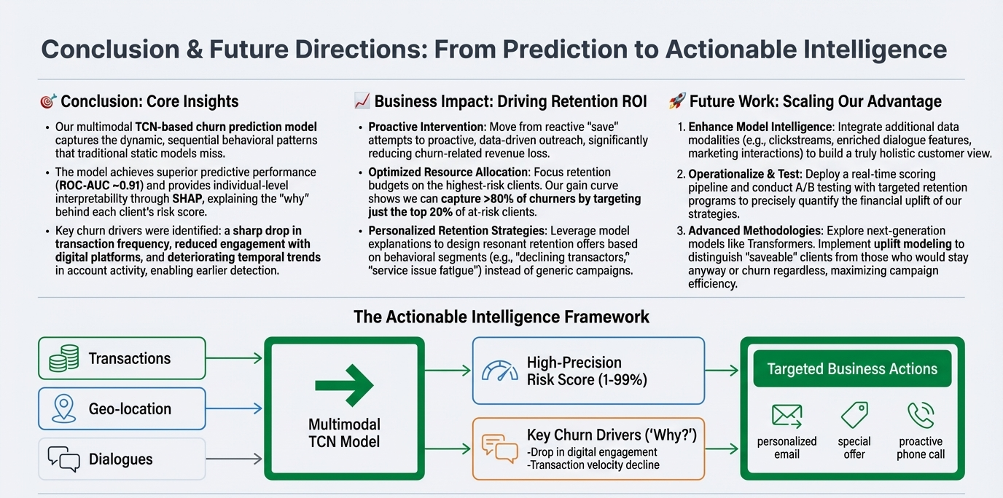




Conclusion & Future Work
🎯 Insights
TCN Model is Best: Our new model tracks behavior over time for churn prediction.
High Accuracy: The model is highly accurate and explains risk clearly (SHAP).
Early Detection: We identified key behavioral drops (transactions, engagement) for early warning.
📈 Business Impact
Be Proactive: Switching to proactive intervention to cut lost revenue.
Targeted ROI: Targeting the top 20% of at-risk clients saves >80% of churners.
Personalized Offers: We use model insights to send offers to customers
🚀 Future Work
Add More Data: Use the newest data to test model
Test and Deploy: Launch real-time scoring and A/B testing to prove strategy works.
Conclusion
By combining transaction, geo, and dialogue data, we created models that tell us of why customers churn.
Models like XGBoost, LightGBM, and GRU performed well and highlighted key churn signals such as recency and engagement.
Feature importance allows us to pinpoint which aspect of customer behavior are the most predictive of churning.
Future Work
Test our models on the 2024 to 2025 data to see if our models still predict churners accurately.
Convert model results into actions so business teams can act quickly (e.g. send promos before a customer churns).
Churn Risk Score (0-99)
Key Churn Drivers
(The “Why’s”)

Slide 16

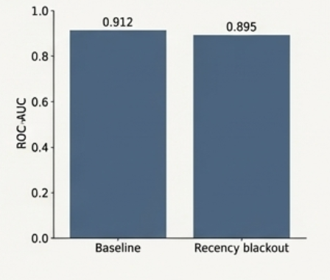
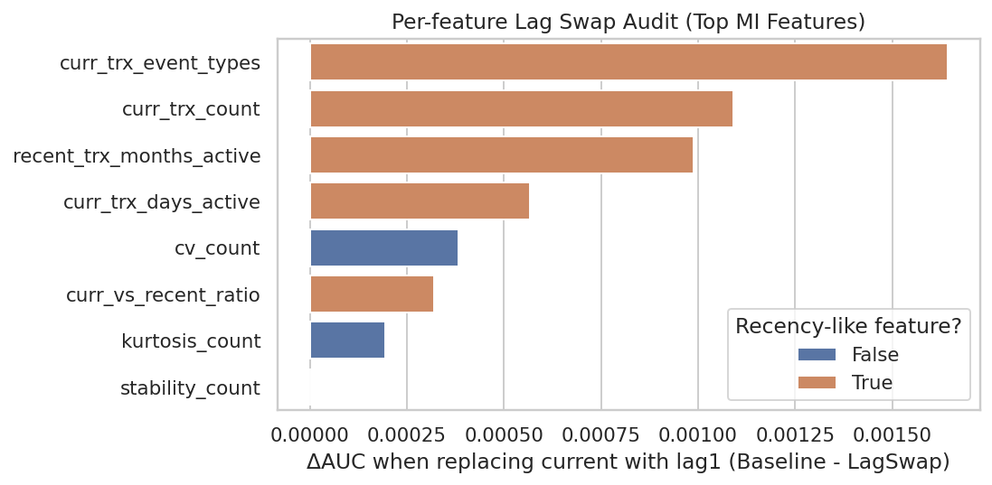
Leakage Prevention Validation
Appendix
Global Recency Blackout check
Feature Level
Strict temporal window confirmation
Confirms that no single feature is a significant leakage source

Slide 17
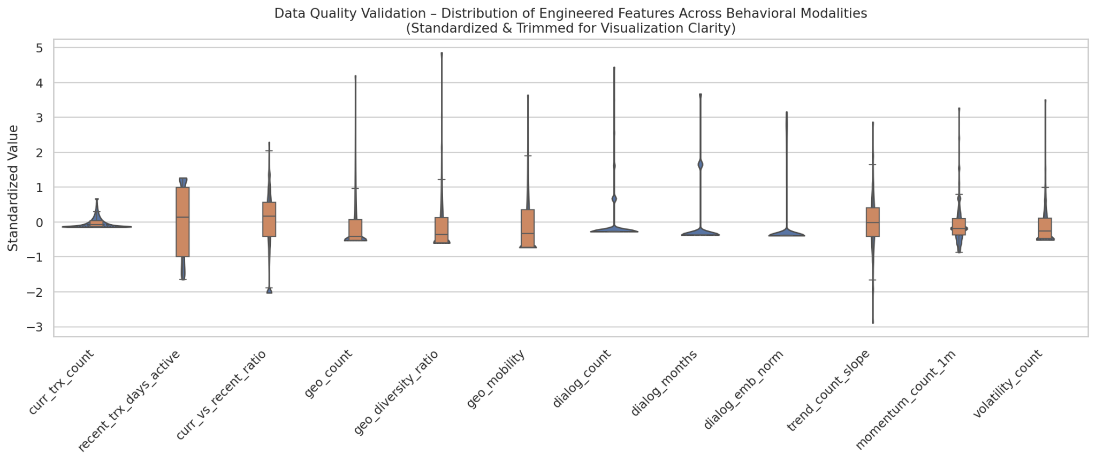
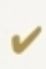
Data Consistency Validation
Appendix
Properly centered after standardization
Healthy variance across all features
No extreme outlier dominance
Distinct modality-wise distributions

